Slide 1


ONLINE AUCTION SYSTEM (C++)
By
Pallavi Sarovar

Slide 2


Index
1. Problem Statement
2. Solution
3. Working (Method / System Flow)
4. Conclusion

Slide 3
Problem Statement
Auction systems are used to sell items where buyers
compete by placing bids.
Manual auction systems can cause:
• Difficulty tracking highest bids
• Errors in recording bids
• Lack of proper bid comparison
The goal is to develop a simple Online Auction
System that allows users to place bids, track
the highest bid, and declare the winner.

Slide 4
Solution
Online Auction System is a C++ console-based
application that simulates a competitive bidding
environment.
Key Features:
• Enter auction item and base price
• Allow users to place bids
• Track highest bid
• Display highest bidder
• Declare auction winner

Slide 5
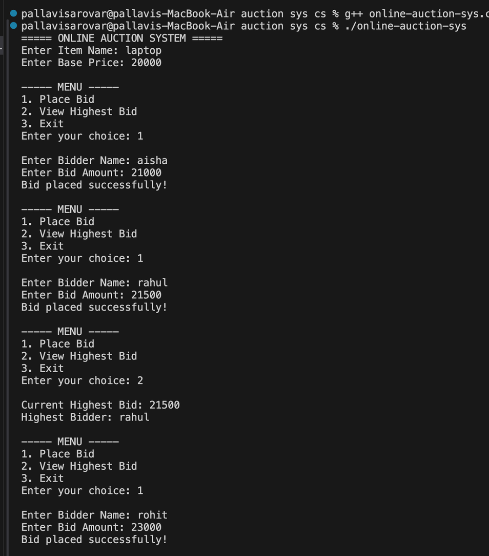
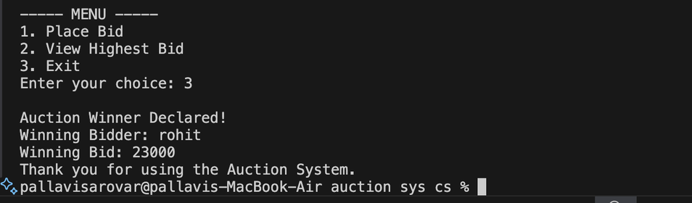
Working of the System
User enters item name and base price
System displays menu options
User selects "Place Bid"
User enters bidder name and bid amount
System compares bid with highest bid
If bid is higher, highest bid is updated
When user exits, the winner is declared
Technologies Used:
• C++
• Conditional Statements
• Loops
• Menu-driven programming

Slide 6
Conclusion
The Online Auction System demonstrates how
competitive bidding can be implemented using
C++ programming.
The system successfully allows users to:
• Place bids
• Track the highest bid
• Determine the winner
This case study helps understand conditional
logic and menu-driven programming in C++.

Slide 7
Thank You

